Slide 1
Building our way to Carbon Neutrality
Sarah Saltzer
April 9, 2024
Notes:
`

Slide 2
Pathways to Carbon Neutrality in California
Phase 1
Phase 2
Phase 3
Fact Finding and Outreach
Topical Deep Dives
Integrated Economy-Wide Model for Carbon Neutrality By 2045
Energy Systems Modeling
Electricity
Transportation
Industry
Commercial
Residential
Hydrogen
Bioenergy
Forest Mgmt
Interviews
Scenarios and Options
Workshop

Slide 3
California’s Historic Emissions and Future Targets
2030 Goal:
40% Reduction from 1990 Emissions Level
256.2 Mt CO₂e
Greenhouse Gas Emissions (MtCO₂e)
2045 Goal:
Carbon Neutrality & Net-Negative Emissions Thereafter
2

Slide 4
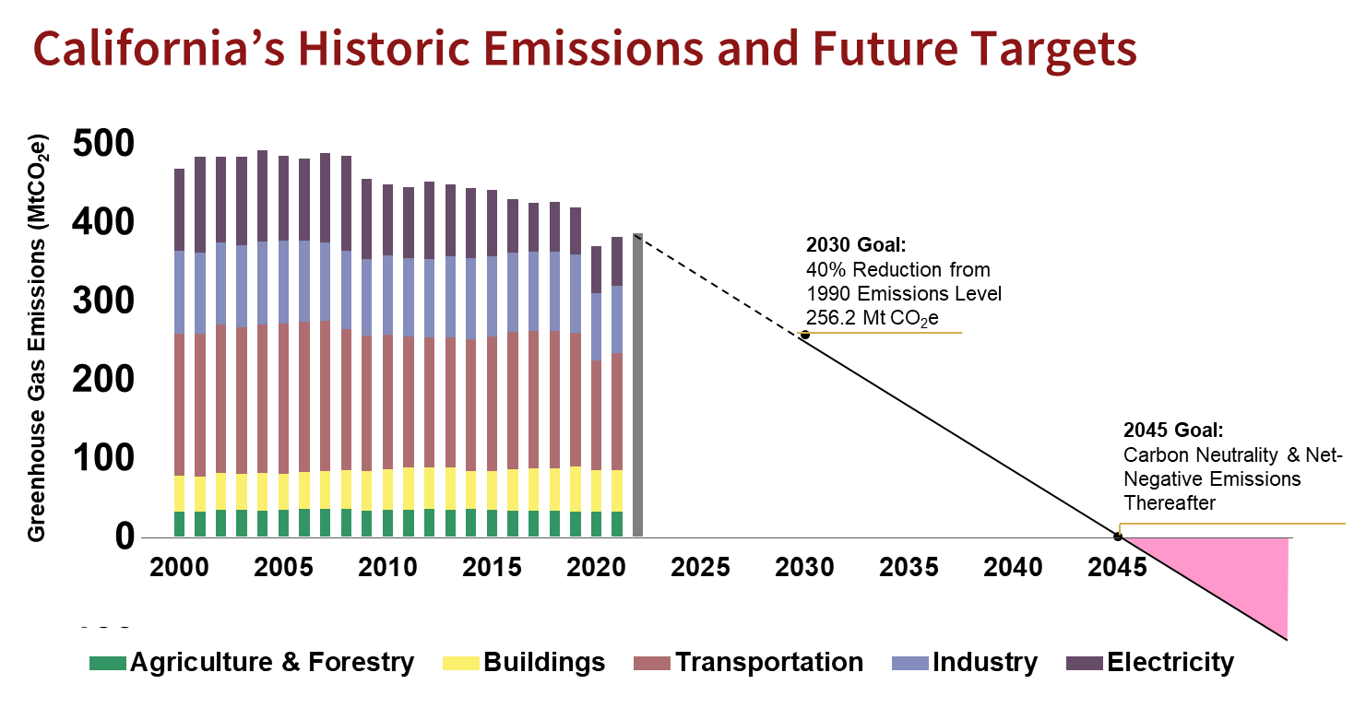
What is it going to take to get to net-zero by 2045?
3

Slide 5
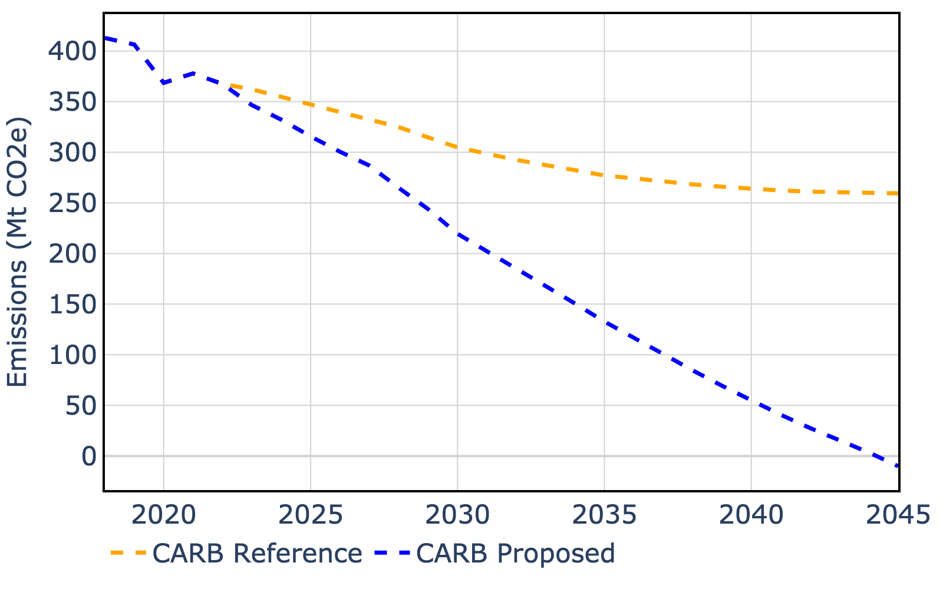
CARB 2022 Scoping Plan
Every five years, CARB creates a scoping plan to lay out a path to help meet climate goals:
CARB Reference Case – CARB’s “business as usual” forecast
CARB Proposed Scenario – CARB’s proposal for reaching net-zero by 2045
Notes:
Reference Scenario “do nothing case” what the GHG emissions would look like if we did nothing at all beyond the existing policies that are required and already in place to achieve the 2030 target of at least 40 percent below 1990 levels,

Slide 6
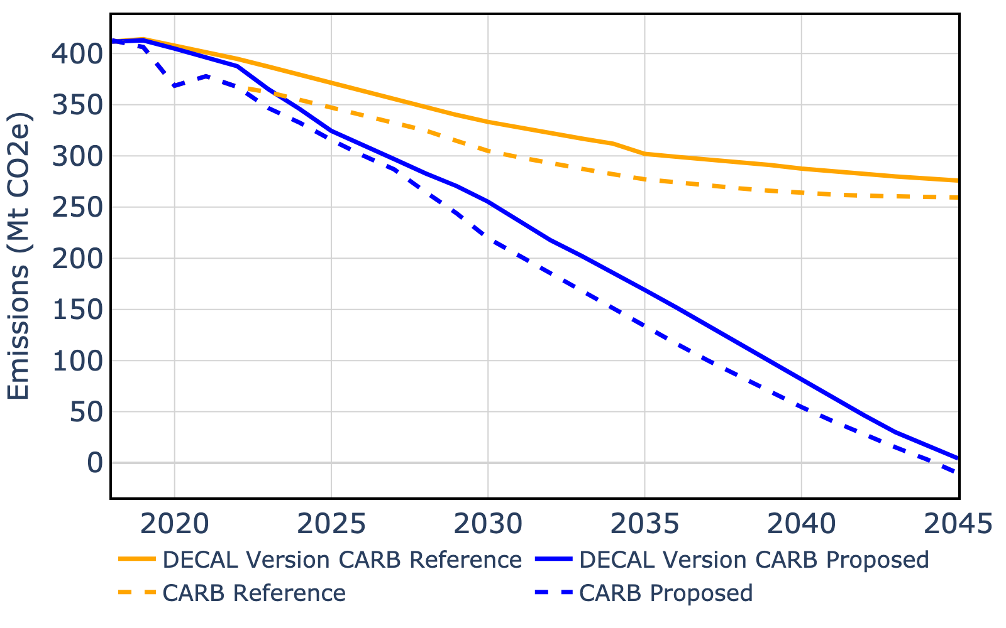
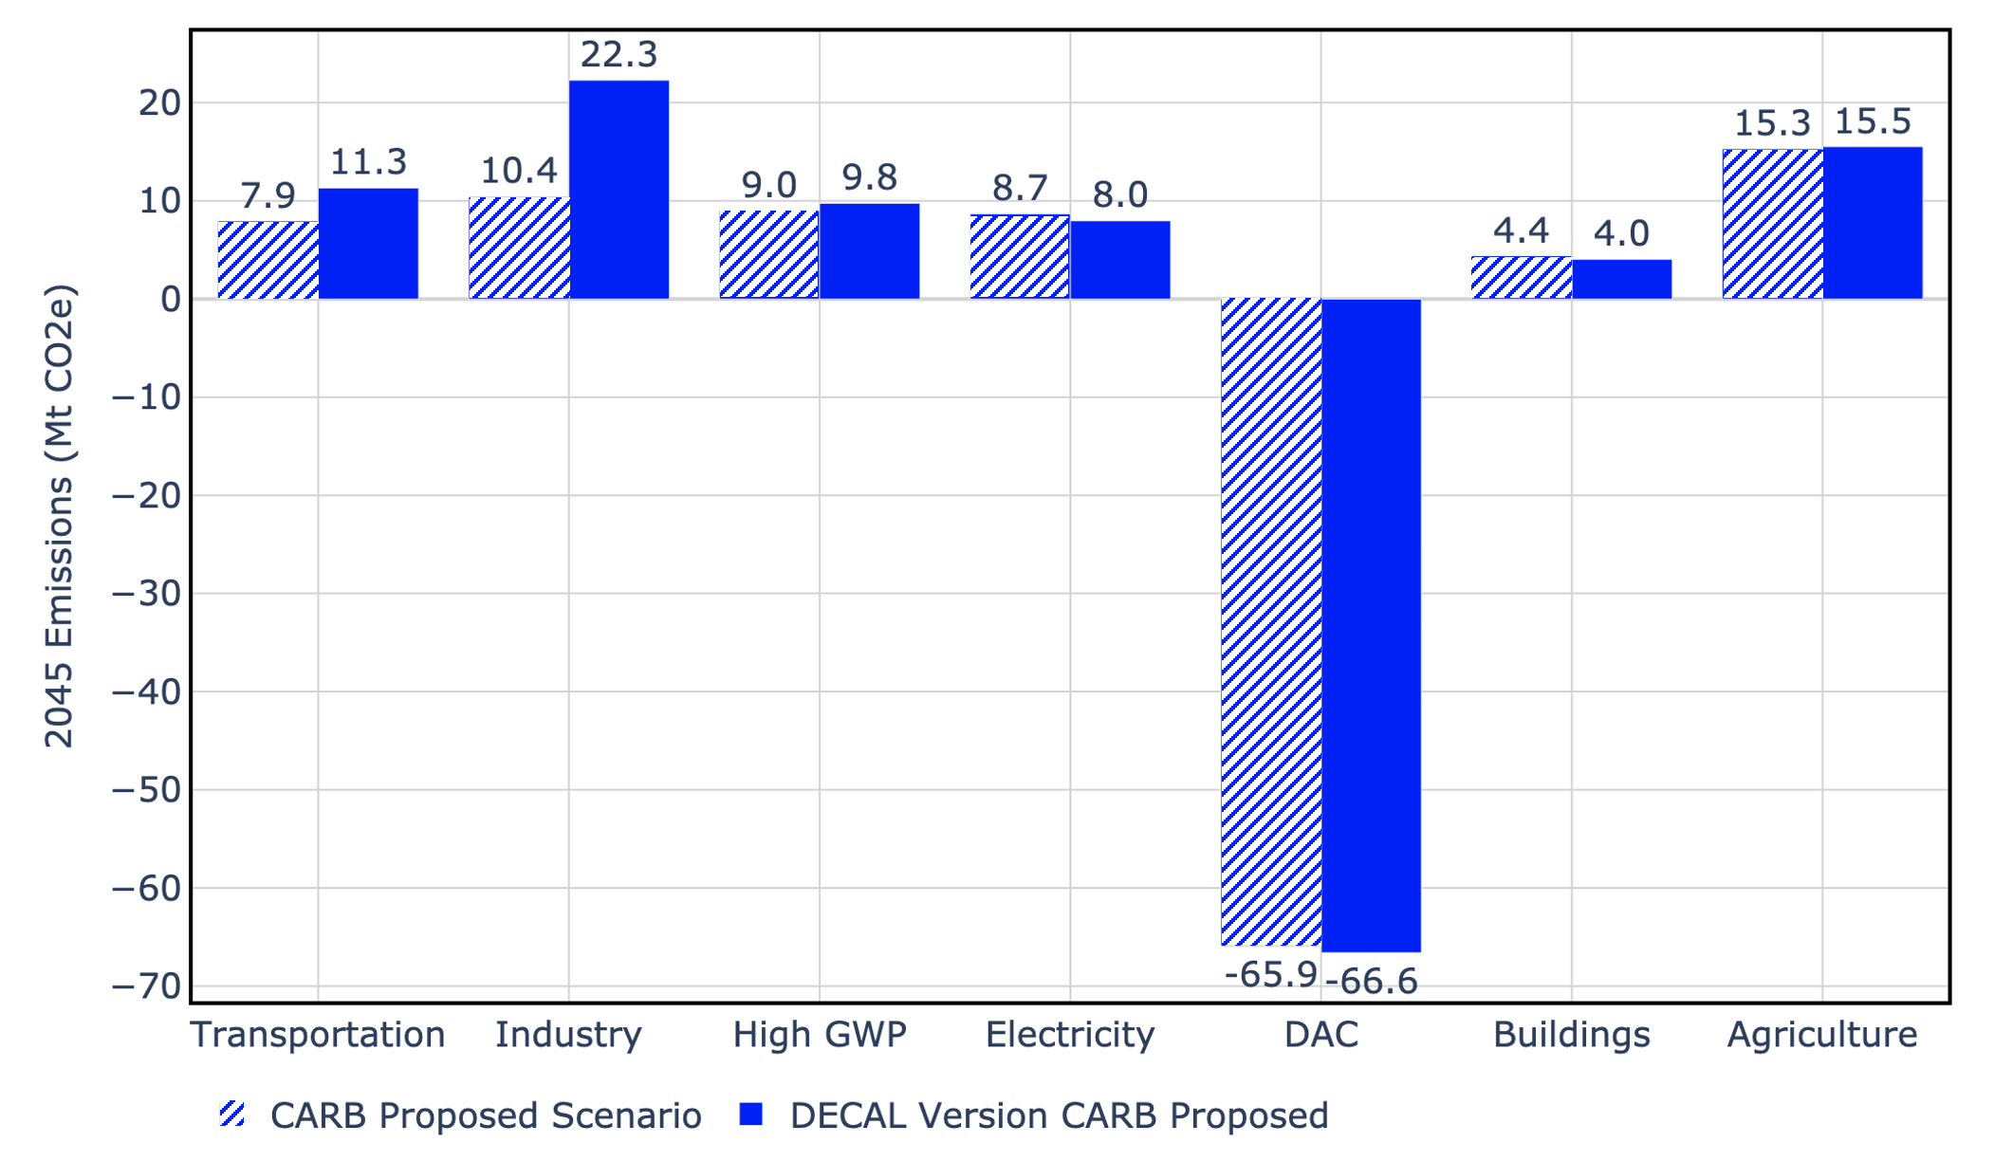
Stanford’s DECAL Model (DEcarbonize CALifornia)
Built using LEAP (Low Emissions Analysis Platform)
3 results we care about most:
Emissions
Costs
Resources
System boundary:
California
Scope 1 & 2 emissions
Model allows us to:
Interrogate the CARB scoping plan
Develop new scenarios
Notes:
Question: Do DECAL and CARB forecasts align?
Method: Convert CARB scenario descriptions into DECAL levers
Plot: Statewide emissions over time
Comparison to Scoping Plan:
Results broadly similar when run under same assumptions
Goal is not to reinvent the CARB Scoping Plan, but to provide an independent analysis and inform the climate mitigation discussion

Slide 7
5 Key Takeaways
Ambitious targets can drive emissions reductions
F-gases need solutions
Unprecedented electricity growth is needed
100% clean electricity generation may NOT be needed
Carbon Capture and Carbon Removal with geologic storage are key to achieving carbon neutrality

Slide 8
Transportation Sector
The Size of the Problem
35 million vehicles, 330 billion miles driven per year, 42 million gallons of gas per day
California Policies
Advanced Clean Cars II Regulation requires 100% of new passenger car and light-duty truck sales to be zero-emission by 2035.
Advanced Clean Truck Program requires all new medium- and heavy-duty vehicles sold in California to be zero-emission by 2045.
Decal Modeling
Bottom up accounting for entire fleet including numbers and types of vehicles, vehicle miles traveled, and GHG emissions
Stock and flow model developed

Slide 9
Transportation Sector Emissions
Modeling assumption: Linear increase in zero emission vehicle (ZEV) sales from today until policy start date
Existing 2035 policy will substantially reduce transport emissions
Gradual progress towards an ambitious target is effective
8
Notes:
Question: What is the effect of ZEV adoption rate on transport emissions?
Method: Modify ZEV sales rates to reach 100% by 2025, 2035, and 2045 (linear interpolation)
Plot: (Left) Statewide emissions over time with 100% ZEV sales by 2025, 2035, and 2045; (Right) Emissions Comparison (today vs. different start year of 100% ZEV sales). Linear interpolation assumed.
Notes:
*These scenarios assume 95% CGC by 2045
*The Advanced Clean Cars II Regulation requires 100% of new passenger car and light-duty truck sales to be zero-emission by 2035
*The Advanced Clean Truck Program requires all new medium- and heavy-duty vehicles sold in California to be zero-emission by 2045
*While there is currently very low ZEV penetration in California, recent LDV adoption rates have increased, with BEVs making up 16% of new car sales in the state in 2022.
* While these policies will drive ZEV sales and are clearly beneficial in reducing transportation emissions, they will not eliminate emissions from this sector by 2045.

Slide 10
Buildings Sector
The Size of the Problem
Residential: ~14 Million existing homes, ~110,000 new builds each year; Energy consumption has distinct daily peaking patterns and seasonal variations
Commercial: over 600,000 buildings; Varying natural gas loads depending on subsector, time of day, season, and climate zone.
California Policies
Several cities are banning natural gas connections for new builds
California’s 2022 Building Code encourages electric heat pumps
CARB is in the process of defining zero-emissions standards for new sales of gas heaters, furnaces, and water heaters, with a likely implementation date of 2030
Decal Modeling
Stock and flow modeling of space and water heating equipment for California’s entire buildings sector, accounting for building type (commercial/residential), use (school, office, retail, restaurant), climate zone.

Slide 11
Buildings Sector Emissions
Existing policies aimed at new homes only has small impact
Gradual progress towards an ambitious goal is effective
A policy to reduce building emissions (e.g. sales of gas appliances) is likely needed
10
Notes:
Question: What is the effect of heat pump adoption rate on buildings sector emissions?
Method: Evaluate heat pump sales rates reaching 100% by 2025, 2035, and 2045 (linearly interpolate)
Plot: (Left) Statewide emissions over time with 100% clean sales by 2025, 2035, and 2045; (Right) Emissions Comparison (today vs. different start year of 100% clean sales)
Notes:
*Remaining building sector emissions are classified as ‘other’ and are not impacted by this scenario
*These scenarios assume 95% CGC by 2045
*CARB is in the process of defining zero-emissions standards for new sales of gas heaters, furnaces, and water heaters, with a likely implementation date of 2030.

Slide 12
5 Key Takeaways
Ambitious targets can drive emissions reductions
F-gases need solutions
Unprecedented electricity growth is needed
100% clean electricity generation may NOT be needed
Carbon Capture and Carbon Removal with geologic storage are key to achieving carbon neutrality

Slide 13
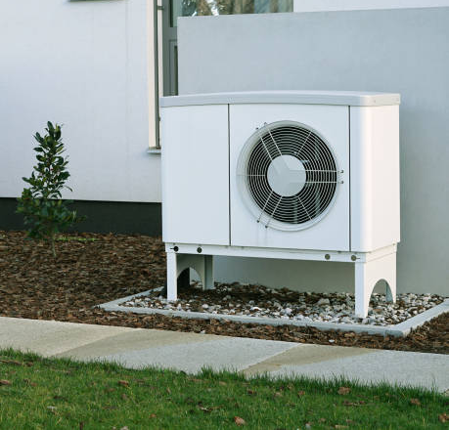
Buildings Sector Decarbonization & Heat Pumps
Heat Pumps
Energy-efficient way to use electricity to transfer heat from cool space to warm space, and vice versa.
Many use a refrigerant (F-gas) with high global warming potential
CARB Proposed scenario assumes we will successfully abate these emissions
Technologies to eliminate f-gasses are very new & expensive → more study and R&D is needed
12
Notes:
Question: How do costs and emissions of different building electrification options compare?
Method: Evaluate ER vs HP under different grid and F-Gas assumptions
Plot: (Left) 2045 Annual Carbon Mitigation; (Right) Additional costs
Notes:
Clean grid/Dirty grid assumes clean F-gases
Clean F-gas/Dirty F-gas assumes clean grid
Electrification of space heating can be done with either electric resistance appliances (including centralized forced-air electric furnaces as well as electric wall and baseboard heaters) or heat pumps. A heat pump transfers heat between the building and the outside air, and can reduce electricity use for heating by ~50% compared to electric resistance heating. Heat pumps can also dehumidify better than typical central air conditioners, and replace the need for a separate air conditioning unit. Heat pump water heaters are also an alternative to electric water heaters in much the same way.

Slide 14
Buildings Sector Decarbonization & Heat Pumps
Heat Pumps
Energy-efficient way to use electricity to transfer heat from cool space to warm space, and vice versa.
Many use a refrigerant (F-gas) with high global warming potential
CARB Proposed scenario assumes we will successfully abate these emissions
Technologies to eliminate f-gasses are very new & expensive → more study and R&D is needed
Emissions from the buildings sector assuming a “no sales of new gas furnaces or water heaters” policy start date of 2030
13
Notes:
Question: How do costs and emissions of different building electrification options compare?
Method: Evaluate ER vs HP under different grid and F-Gas assumptions
Plot: (Left) 2045 Annual Carbon Mitigation; (Right) Additional costs
Notes:
Clean grid/Dirty grid assumes clean F-gases
Clean F-gas/Dirty F-gas assumes clean grid
Electrification of space heating can be done with either electric resistance appliances (including centralized forced-air electric furnaces as well as electric wall and baseboard heaters) or heat pumps. A heat pump transfers heat between the building and the outside air, and can reduce electricity use for heating by ~50% compared to electric resistance heating. Heat pumps can also dehumidify better than typical central air conditioners, and replace the need for a separate air conditioning unit. Heat pump water heaters are also an alternative to electric water heaters in much the same way.

Slide 15
5 Key Takeaways
Ambitious targets can drive emissions reductions
F-gases need solutions
Unprecedented electricity growth is needed
100% clean electricity generation may NOT be needed
Carbon Capture and Carbon Removal with geologic storage are key to achieving carbon neutrality

Slide 16
Demand for Electricity (Load)
Due to electrification of cars, buildings and industry, we will see the following:
Significant increase in electricity demand
This scenario shows a 40 GW increase in peak load from today (range across all our scenarios 20-70 GW)
Will require major capacity expansions to the grid
Representative 24-hour average daily load curve for the month
Jan | Feb | Mar | Apr | May | Jun | Jul | Aug | Sep | Oct | Nov | Dec
15

Slide 17
5 Key Takeaways
Ambitious targets can drive emissions reductions
F-gases need solutions
Unprecedented electricity growth is needed
100% clean electricity generation may NOT be needed
Carbon Capture and Carbon Removal with geologic storage are key to achieving carbon neutrality

Slide 18
Policies Impacting the Electricity Sector
Senate Bill 100 requires a 100% Clean Electricity Grid by 2045
Pumped hydro, Solar, Wind, Nuclear, Geothermal are all 100% Clean
Natural Gas Combined Cycle Power Plants with Carbon Capture Retrofits (NGCCS) are not 100% clean
It is unclear if NGCCS can be part of a 100% clean grid in 2045
What impact will this have on the grid, especially since it needs to grow?
17
Notes:
Question: How do costs and emissions of different building electrification options compare?
Method: Evaluate ER vs HP under different grid and F-Gas assumptions
Plot: (Left) 2045 Annual Carbon Mitigation; (Right) Additional costs
Notes:
Clean grid/Dirty grid assumes clean F-gases
Clean F-gas/Dirty F-gas assumes clean grid
Electrification of space heating can be done with either electric resistance appliances (including centralized forced-air electric furnaces as well as electric wall and baseboard heaters) or heat pumps. A heat pump transfers heat between the building and the outside air, and can reduce electricity use for heating by ~50% compared to electric resistance heating. Heat pumps can also dehumidify better than typical central air conditioners, and replace the need for a separate air conditioning unit. Heat pump water heaters are also an alternative to electric water heaters in much the same way.

Slide 19
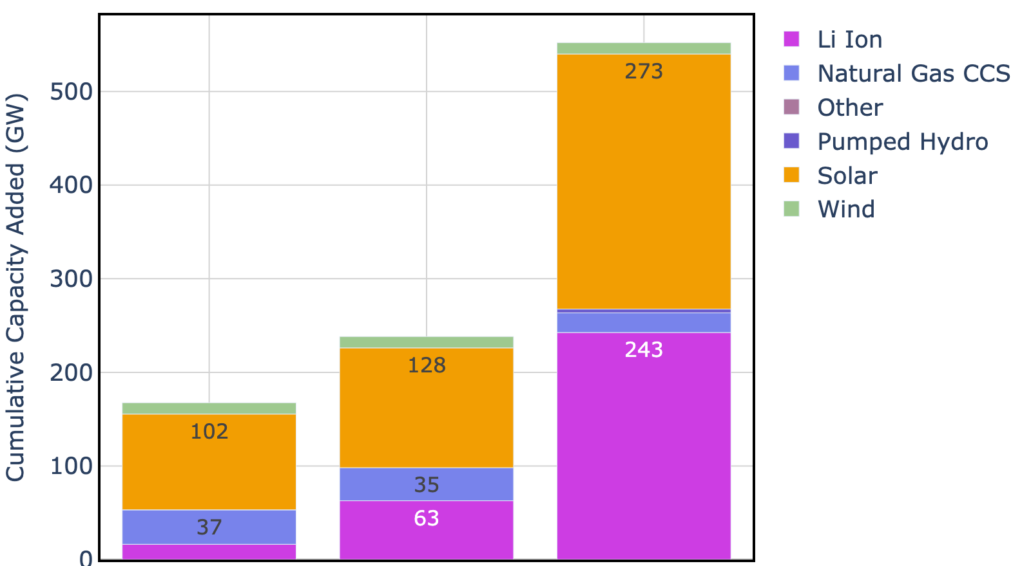
Electricity Sector Capacity Additions
Excess reliable capacity is needed to meet load/demand
Magnitude of capacity additions depend on how ‘clean’ the electricity needs to be…
The cleaner the grid requirement, the more we need to overbuild solar/batteries to meet rare peak events
95% Clean
Grid
97.5% Clean
Grid
100% Clean
Grid
Note: NGCCS gets turned off in 2045

Slide 20
Electricity Sector Capacity Additions
Range of capacity additions:
170-550 GW
Impact on emissions between these 3 scenarios is < 5 Mt CO2/yr
Current capacity: 80 GW
Added since 2000: 29 GW
Perhaps a 97.5% clean grid (which allows for some NGCCS) is sufficient
95% Clean
Grid
97.5% Clean
Grid
100% Clean
Grid
Note: NGCCS gets turned off in 2045

Slide 21
What is all this electricity for?

Slide 22
5 Key Takeaways
Ambitious targets can drive emissions reductions
F-gases need solutions
Unprecedented electricity growth is needed
100% clean electricity generation may NOT be needed
Carbon Capture and Carbon Removal with geologic storage are key to achieving carbon neutrality

Slide 23
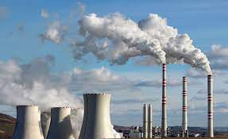
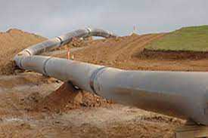
Carbon Capture and Storage (CCS)
Over 400 emitting industrial facilities in many different sub sectors, some of which require very high heat
Over 250 gas-fired power plants exist (today) in the electricity sector
CCS is a proven technology that can affordably (with incentives) abate these emissions
CARB Scoping Plan requires 25 Mt/yr of CCS by 2045
Capture
Transportation
Storage

Slide 24
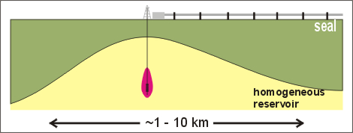
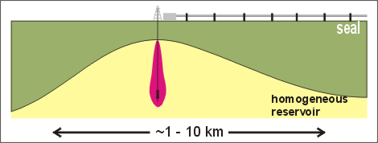
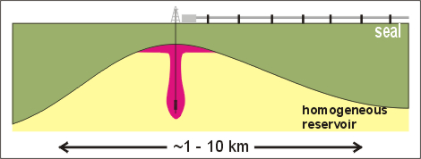
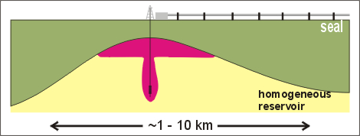
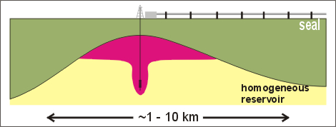
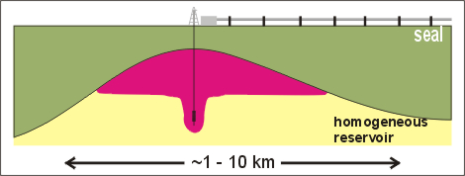
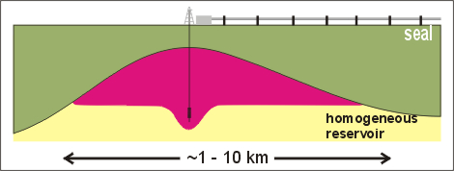
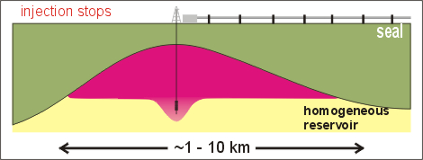
Carbon Capture and Storage (CCS)
Over 400 emitting industrial facilities in many different sub sectors, some of which require very high heat
Over 250 gas-fired power plants exist (today) in the electricity sector
CCS is a proven technology that can affordably (with incentives) abate these emissions
CARB Scoping Plan requires 25 Mt/yr of CCS by 2045

Slide 25
Carbon Dioxide Removal (CDR)
What is CDR?
Technologies that remove CO₂ from the atmosphere.
Also known as “negative emissions technologies”
In 2045, CARB Scoping Plan requires:
Direct air capture (DAC) w/ geologic storage ~65 Mt
Biomass carbon removal (BECCS/BiCRS) ~9 Mt
Natural climate solutions from working lands ~1 Mt

Slide 26
Direct Air Capture (DAC)
Current Status: 18 DAC plants operating capturing 0.01 Mt/yr. Majority of captured CO₂ is used in beverage industry
A 1 Mt/yr plant is in development in TX and 11 more large-scale plants are in development which could result in 5.5 Mt/yr by 2030
IEA Net Zero scenario (for the globe) requires 5.5 Mt/yr by 2030
CARB 2022 Scoping Plan (for CA) requires:
2.3 Mt/yr by 2030
6.6 Mt/yr by 2031
25

Slide 27
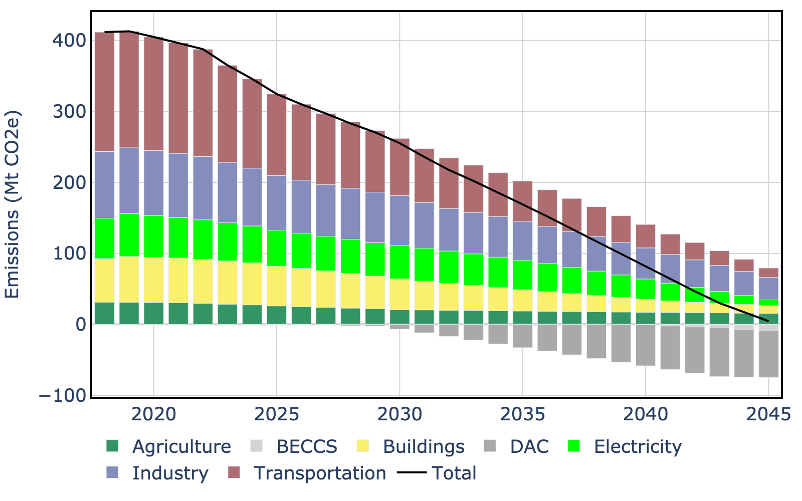
Carbon Capture and Removal
Transportation Sector:
Electrification and fuel switching (H2, RD, RNG)
Buildings Sector
Electrification and fuel switching (RNG)
Industrial Sector
CCS and Electrification
Electricity Sector
CCS & Renewables
In 2045, ~75 Mt/yr remain in the system
DAC: 67 MT
BECCS: 8 Mt
DECAL version of CARB Ref Case
Notes:
By having our own model, we can interrogate the scoping plan and gather more insight.

Slide 28
5 Key Takeaways
6
Ambitious targets can drive emissions reductions
F-gases need solutions
Unprecedented electricity growth is needed
100% clean electricity generation may NOT be needed
Carbon Capture and Carbon Removal with geologic storage are key to achieving carbon neutrality
Carbon Neutrality can not be reached without the Building Trades

Slide 29
Thank You to our Sponsors

Slide 30
DEcarbonize CALifornia (DECAL) Model
Inputs
Model
Outputs
Activity Level
Stock/Sales
Capacity
LEAP
Emissions
State Perspective
Boundary: California
Scope 1 & 2 Emissions
Energy Intensity
Process Efficiency
Energy Demand
Demand
Capital Costs
Operational Costs
Fuel Costs
Incentives
Transformation
Non-Energy
Cost
Scenario-Based
Stock & Flow
Optimization
Policy/Technology Measures

Slide 31
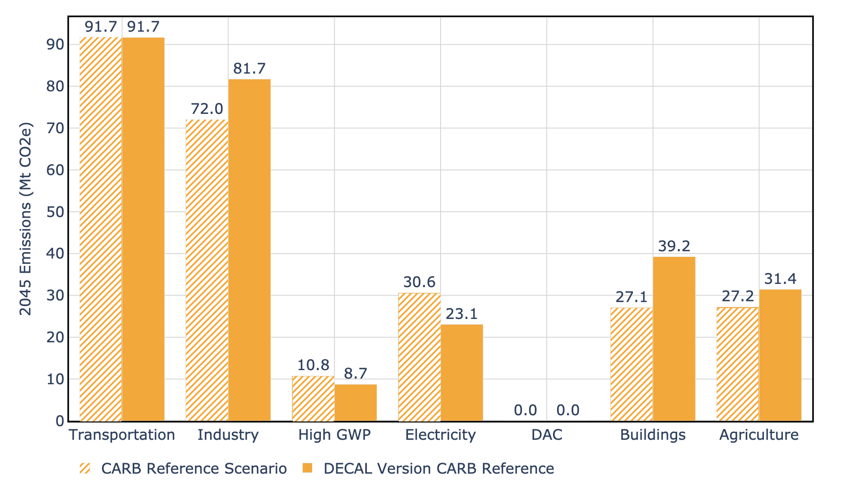
Comparison to Scoping Plan
Having our own model allows us to:
Interrogate the CARB scoping plan
Develop new scenarios
Notes:
Question: Do DECAL and CARB forecasts align?
Method: Convert CARB scenario descriptions into DECAL levers
Plot: Statewide emissions over time
Comparison to Scoping Plan:
Results broadly similar when run under same assumptions
Goal is not to reinvent the CARB Scoping Plan, but to provide an independent analysis and inform the climate mitigation discussion

